Slide 1
How American Homicide Changed Over This Decade
An Exploratory Data Analysis
By Hafsa and Nicole

Slide 2


How do murder rates in 2020 differ from 2010?
Did per capita homicide rates rise this decade? Is there a correlation between population size and murder rates? Together, we will explore state crime statistics from the Federal Bureau of Investigation to answer these questions.

Slide 3
State Homicide Per Capita by Year
Did homicide rates in 2020 increase from 2010 rates (adjusted for population growth)?
Let’s take a look at how per capita rates for each state compared between years:

Slide 4
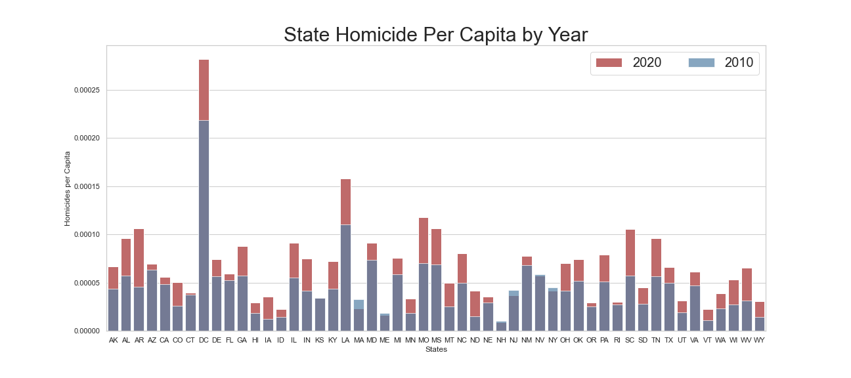
Here you can see that, but for only 3 exceptions, murder rates were higher in 2020 than in 2010 across the entire nation! Important to note: these are PER CAPITA rates, and so are adjusted for population growth.
Notes:
Here you can see that, but for only 3 exceptions, murder rates were higher in 2020 than in 2010 across the entire nation! Important to note: these are PER CAPITA rates, and so are adjusted for population growth.

Slide 5
Homicides per Capita per Population Size
Do murders occur more often when more people live together?
Let’s now examine a depiction of how homicide per capita compares to state population:

Slide 6
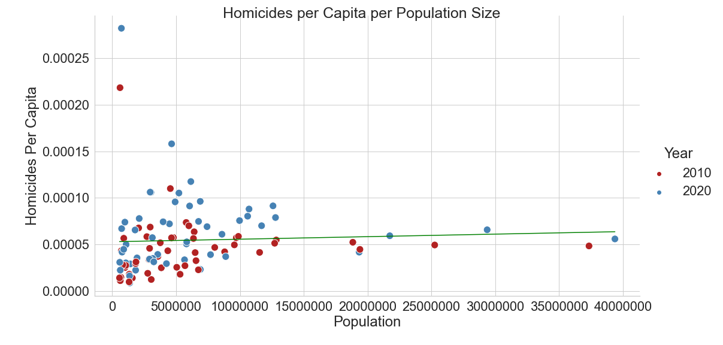
This data shows almost NO correlation between per capita murder rates and state population size. The correlation coefficient calculated by np.corrcoef = 0.04932725. That is less than 5%, and as you can see, there are plenty of outliers

Slide 7
National Homicide Per Capita
Finally, we ask: How did murder rates for the entire country in 2020 compare to a decade prior?
With quarantine measures in effect, we hypothesized that homicide rates would be higher for the year 2020. Let’s see if that is supported or refuted:

Slide 8
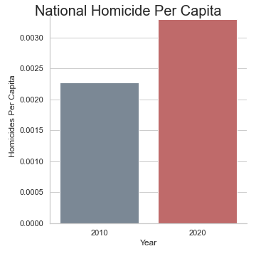
These rates are adjusted for population growth. Therefore, there is a clear and statistically significant increase in homicides between 2020 and 2010. While this data does not indicate why homicide rates jumped last year, the higher rates mean that our hypothesis is ...
Notes:
These rates are adjusted for population growth. Therefore, there is a clear increase in homicides between 2020 and 2010. While this data does not indicate why homicide rates spiked last year, Hafsa’s hypothesis as been:

Slide 9
Thank you!
Regards, Hafsa & Nicole
Notes:
Thank you! Regards, Hafsa&Nicole

